Slide 1

Telecom Customer Churn Analysis
Presented By
Sakshi Patil

Slide 2
Discussion Flow
Problem Overview
Data Overview
Data Preparation
Key Visuals and Dashboard
Insights and Key Findings
Conclusion

Slide 3
Problem Overview
The telecom industry is highly competitive, making customer retention critical for business growth.
Even small increases in churn result in significant revenue loss and higher acquisition costs.
Many companies lack clear insights into why customers leave.
Retention efforts are often reactive due to limited data-driven analysis.
There is a strong need for analytical solutions to identify churn drivers, predict high-risk customers, and reduce revenue loss.

Slide 4
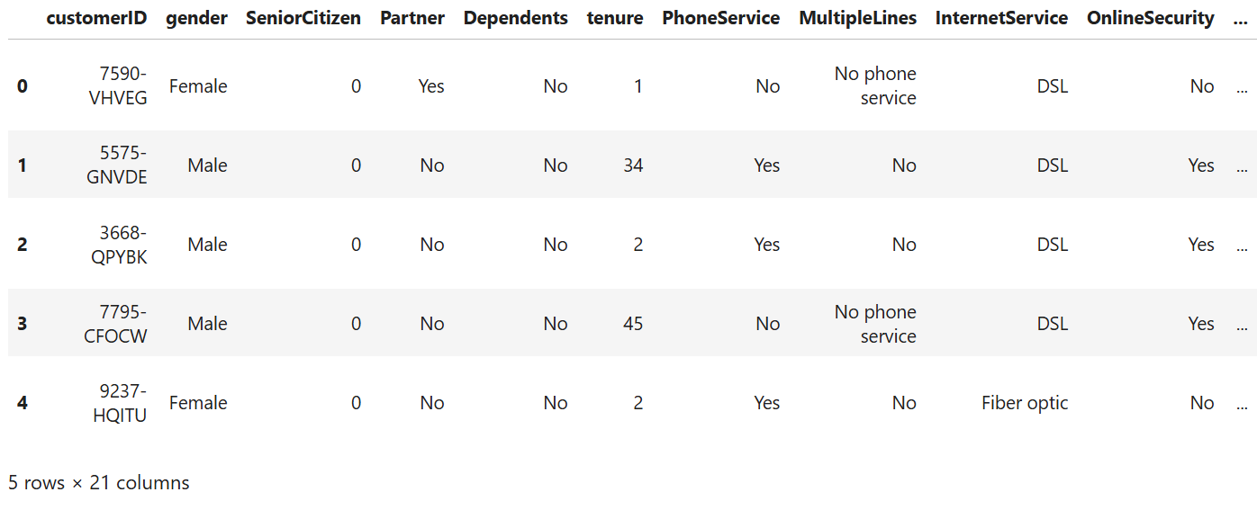
Data Overview
Dataset :
Dataset Name: Telecom Customer Churn Dataset
Dataset shape : (7043 Rows, 21 Columns)
.

Slide 5
Dataset Description
Customer Demographics: Gender, senior citizen status, and partner/dependent information
Service Details: Internet service type, phone service, and add-on services such as online backup and tech support
Contract Information: Contract type and customer tenure
Billing & Payment: Monthly charges, total charges, and payment methods
Target Variable: Churn status indicating whether a customer has left or stayed

Slide 6
Data Preparation
Imported and cleaned the data in Power BI to remove missing and inconsistent values.
Transformed data using Power Query, including correcting data types like Total Charges.
Standardized categorical fields, converting values such as Senior Citizen from 0/1 to Yes/No.
Created calculated columns like Tenure Groups and Total Services for better analysis.
Built DAX measures for key metrics including churn rate, customer count, and revenue impact.

Slide 7


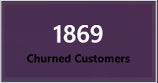

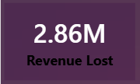
Key Visuals and Dashboards
Total customers in the dataset: 7,043
26.54% overall churn rate indicates notable customer loss
1,869 customers have churned
5,174 customers are currently retained
Customer churn has led to 2.86M in revenue loss

Slide 8
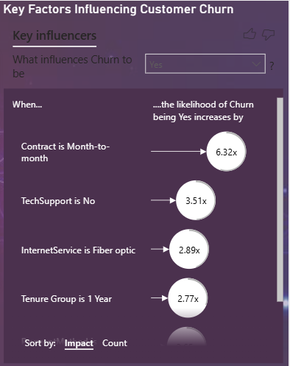
Key Factors Influencing Customer Churn
The visual identifies the strongest factors that influence whether a customer will churn.
It compares how different contract types, services, and tenure levels affect churn likelihood.
Insights
Customers on month-to-month contracts show the highest churn risk.
Lack of technical support and use of fiber optic internet significantly increase the chance of churn

Slide 9
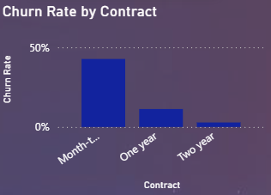
Churn Rate by Contract Type
This chart compares customer churn rates across different contract durations.
It shows how contract length impacts customer retention.
Insights
Month-to-month contracts have the highest churn rate.
Churn decreases significantly for one-year and is lowest for two-year contracts, showing longer contracts improve retention.

Slide 10
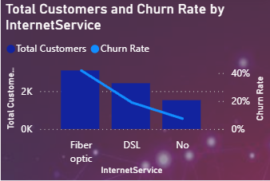
Total Customers and Churn Rate by Internet Service
This visual compares the total number of customers with churn rate across different internet service types.
It highlights how customer volume and churn behavior vary by service.
Insights
Fiber optic has the highest churn rate despite having a large customer base.
DSL shows moderate churn, while customers with no internet service have the lowest churn rate.

Slide 11
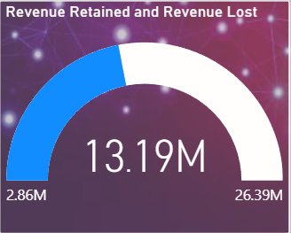
Revenue Retained and Revenue Lost
This gauge shows the comparison between revenue retained from active customers and revenue lost due to churn.
It provides a quick view of the financial impact of customer churn.
Insights
2.86M revenue has been lost due to churned customers.
The majority of revenue (13.19M retained) still comes from active customers, highlighting the importance of reducing churn to protect revenue.

Slide 12
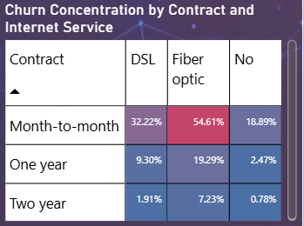
Churn Concentration by Contract and Internet Service
This heatmap shows how customer churn is distributed across different contract types and internet services.
Darker colors indicate higher churn concentration.
Insights
Month-to-month customers using fiber optic internet have the highest churn concentration.
Churn is significantly lower for one-year and two-year contracts, especially for customers without internet or using DSL.

Slide 13
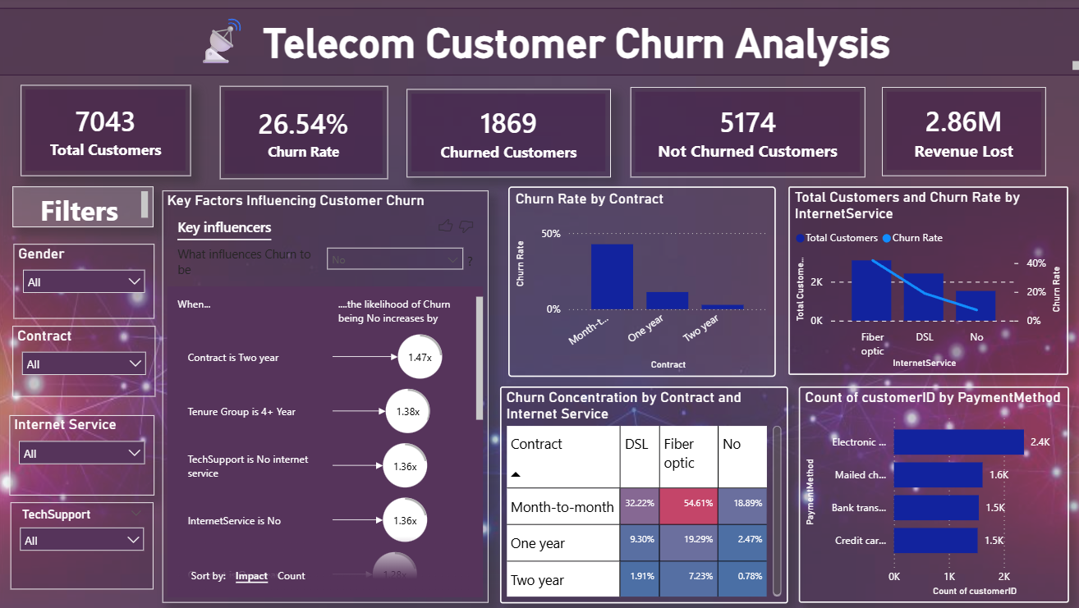
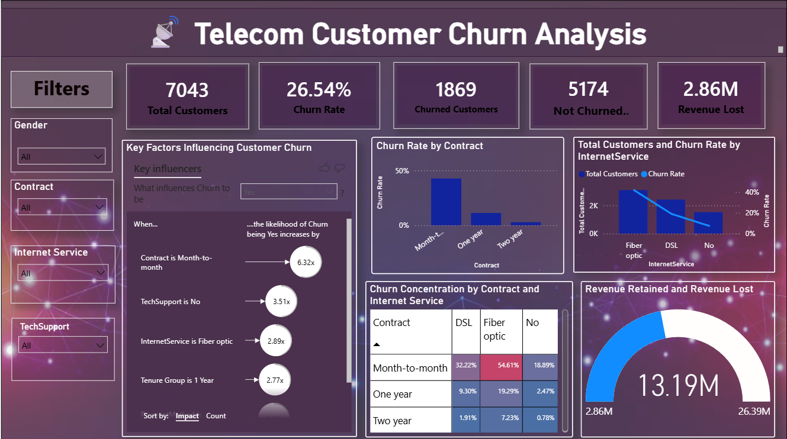

Slide 14
Insights and Key findings
Churn is highest among short-tenure customers, month-to-month contracts, and fiber optic users.
Contract type is the strongest churn driver, with long-term contracts improving retention.
Lack of technical support and use of electronic check payments increase churn risk.
High-risk customers contribute disproportionately to churn and revenue loss.
Nearly 17.83% of total revenue is lost due to churn, making it a major financial concern.
Recommendations
Promote long-term contracts to reduce churn.
Target high-risk and new customers with early retention offers.
Improve fiber optic service quality and support.
Encourage use of technical support services.
Shift customers to reliable, automated payment methods.

Slide 15
Conclusion
Customer churn in the telecom industry is primarily driven by contract type, tenure, and service experience.
Month-to-month contracts and short-tenure customers exhibit the highest churn and represent the greatest retention opportunity.
Lack of technical support and certain billing methods further increase churn risk.
Churn risk segmentation enables early identification of high-risk customers, allowing proactive intervention.
Targeted retention strategies can significantly reduce revenue loss and improve customer lifetime value.
Power BI Dashboard

Slide 16

THANK YOU

